Slide 1
CHAPTER Two
DATA MODELING USING ENTITY RELATIONSHIP DIAGRAMS

Slide 2
Using high level Data models for Database Design
The Entity-Relationship (ER) model, Is a popular high, level conceptual data model
Database Design Process
requirements collection and analysis:
Here, the database designers interview prospective database users to understand and document their data requirements
The result of this step is a concisely written set of users’ requirements
Functional requirements:
these are also specified in parallel with requirement collection
These consist of the user-defined operations (or transactions) that will be applied to the database, including both retrievals and updates.
conceptual design:.
Once all the requirements have been collected and analyzed, the next step is to create a conceptual schema for the database, using a high-level conceptual data model
includes detailed descriptions of the entity types, relationships, and constraints

Slide 3
logical design or data model mapping:
Deals with the actual implementation of the database
use an implementation data model such as the relational or the object-relational database model-so the conceptual schema is transformed from the high-level data model into the implementation data model
Physical design:
Here the internal storage structures, indexes, access paths, and file organizations for the database files are specified
For more detail see
FIGURE 3.1 A simplified diagram to illustrate the main phases of database design on page 51

Slide 4
Example of Database Application
The COMPANY database keeps track of a company's employees, departments, and projects. After requirement analysis phase, the DB designers provided the following description.
The company is organized into departments. Each department has a unique name, a unique number, and a particular employee who manages the department.
We keep track of the start date when that employee began managing the department. A department may have several locations.
2. A department controls a number of projects, each of which has a unique name, a unique number, and a single location.
3. We store each employee's name, social security number, address, salary, sex, and birth date. An employee is assigned to one department but may work on several projects, which are not necessarily controlled by the same department. We keep track of the number of hours per week that an employee works on each project. We also keep track of the direct supervisor of each employee.
4. We want to keep track of the dependents of each employee for insurance purposes. We keep each dependent's first name, sex, birth date, and relationship to the employee.

Slide 5
ENTITY TYPES, ENTITY SETS,ATTRIBUTES, AND KEYS
The ER model describes data as entities, relationships, and attributes.
Entity:
The basic object that the ER model represents is an entity, which is a "thing" in the real world with an independent existence.
An entity may be an object with a physical existence
for example, a particular person, car, house
it may be an object with a conceptual existence
for example, a company, a job, or a university course.
Attribute:
Each entity has attributes-the particular properties that describe it.
For example, an employee entity may be described by the employee's name, age, address, salary, and job. A particular entity will have a value for each of its attributes

Slide 6
Types of attributes
Composite versus Simple (Atomic) Attributes:
Composite attributes can be divided into smaller subparts, which represent more basic attributes with independent meanings.
For example, the Address attribute of the employee entity can be subdivided into StreetAddress, City, State, and Zip.
Attributes that are not divisible are called simple or atomic attributes
Composite attributes can form a hierarchy; for example, StreetAddress can be further subdivided into three simple attributes: Number, Street, and ApartmentNumber
if there is no need to refer to the individual components of an address (zip code, street, and so on), then the whole address can be designated as a simple attribute.

Slide 7
Single-Valued versus Multivalued Attributes
single-valued: Most attributes have a single value for a particular entity; such attributes are called single-valued. For example, Age is a single-valued attribute of a person.
Multivalued: In some cases an attribute can have a set of values for the same entity-for example, a Colors attribute for a car, or a CollegeDegrees attribute for a person Such attributes are multivalued attributes
Stored versus Derived Attributes
derived attribute:
in some cases, two (or more) attribute values are related-
for example, the Age and BirthDate attributes of a person.
For a particular person entity, the value of Age can be determined from the current (today's) date and the value of that person's BirthDate
The Age attribute is hence called a derived attribute and is said to be derivable from the BirthDate attribute which is called a stored attribute

Slide 8
Null VaIues:
In some cases a particular entity may not have an applicable value for an attribute
For example, the ApartmentNumber attribute of an address applies only to addresses that are in apartment buildings and not to other types of residences, such as single-family homes.
Similarly, a CollegeDegrees attribute applies only to persons with college degrees ( when it is not applicable)
Null can also be used if we do not know the value of an attribute for a particular entity
for example, if we do not know the home phone of "John Smith“( when it is unknown)

Slide 9
Complex attributes:
Composite and multivalued attributes can be nested
by grouping components of a composite attribute between parentheses () and separating the components with commas, and by displaying multivalued attributes between braces
For example, if a person can have more than one residence and each residence can have multiple phones, an attribute AddressPhone for a person can be specified as
{AddressPhone( {Phone(AreaCode,PhoneNumber)},Address(StreetAddress(Number,Street,ApartmentNumber),City,State,Zip) ) }

Slide 10
Entity Types, Entity Sets, Keys, and Value Sets
Entity type:
defines a collection (or set) of entities that have the same attributes.
Ex: company employing hundreds of employees may want to store similar information concerning each of the employees
These employee entities share the same attributes, but each entity has its own value(s) for each attribute
Each entity type in the database is described by its name and attributes
entity set:
The collection of all entities of a particular entity type in the database at any point in time
For example, EMPLOYEE refers to both a type of entity as well as the current set of all employee entities in the database.

Slide 11
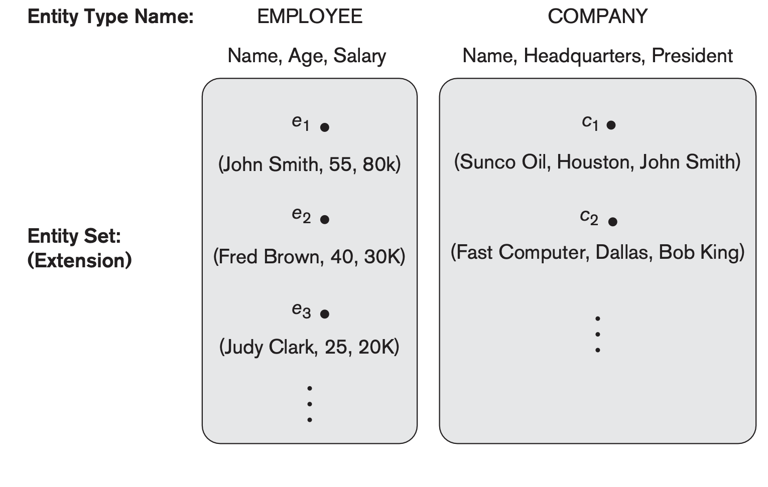
Figure: Two entity types, EMPLOYEE and COMPANY, and some member entities of each.

Slide 12
Key Attributes of an Entity Type:
An important constraint on the entities of an entity type is the key or uniqueness constraint on attributes
An entity type usually has an attribute whose values are distinct for each individual entity in the entity set.
Such an attribute is called a key attribute, and its values can be used to identify each entity uniquely
For example, the Name attribute is a key of the COMPANY entity type because no two companies are allowed to have the same name.
For the PERSON entity type, a typical key attribute is SocialSecurityNumber
Sometimes, several attributes together form a key, meaning that the combination of the attribute values must be distinct for each entity.
If a set of attributes possesses this property, the proper way to represent this in the ER model is to define a composite attribute and designate it as a key attribute of the entity type
each key attribute has its name underlined inside the oval

Slide 13
Some entity types have more than one key attribute
For example, each of the VehicleID and Registration attributes of the entity type CAR is a key in its own right
CAR:
Registration(RegistrationNumber, State), VehiclelD, Make, Model, Year, {Color}
Ex:Car1 : ( (ABC 123, TEXAS), TK629, Ford Mustang, convertible, 1998, {red, black})
car2: ( (ABC 123, NEW YORK), WP9872, Nissan Maxima, 4-door, 1999, {blue})
car 3: ( (VSY 720, TEXAS), TD729 , Chrysler LeBaron, 4-door, 1995, {white, blue})
The Registration attribute is an example of a composite key formed from two simple component attributes, RegistrationNumber and State, neither of which is a key on its own
Weak entity type:
An entity type may also have no key, in which case it is called a weak entity type

Slide 14
Value sets(Domains of attribute)
Each simple attribute of an entity type is associated with a value set (or domain of values), which specifies the set of values that may be assigned to that attribute for each individual entity
Ex we can specify the value set of the Age attribute of EMPLOYEE to be the set of integer numbers between 16 and 70
Value sets are typically specified using the basic data types available in most programming languages, such as integer, string, boolean, float, enumerated type, and so on

Slide 15
Initial Conceptual Design of the COMPANY Database
we can identify four entity types-one corresponding to each of the four items in the specification
1. An entity type DEPARTMENT with attributes Name, Number, Locations, Manager, and ManagerStartDate. Locations is the only multivalued attribute. We can specify that both Name and Number are (separate) key attributes, because each was specified to be unique.
2. An entity type PROJECT with attributes Name, Number, Location, and ControllingDepartment. Both Name and Number are (separate) key attributes.
3. An entity type EMPLOYEE with attributes Name, SSN (for social security number),Sex, Address, Salary, BirthDate, Department, and Supervisor.
4. An entity type DEPENDENT with attributes Employee, dependentName, Sex, BirthDate, and Relationship (to the employee).

Slide 16
DEPARTMENT
Name, Number, {Locations}, Manager, ManagerStartDate
PROJECT
Name, Number, Location, ControllingDepartment
EMPLOYEE
Name(FName, Mlnit, LName), SSN,Sex, Address, Salary,
BirthDate, Department, Supervisor,
WorksOn
(Project, Hours)}
DEPENDENT
Employee, DependentName, Sex,BirthDate, Relationship

Slide 17
RELATIONSHIPS IN DAATABASE
Relationship:
is whenever an attribute of one entity type refers to another entity type, some relationship exists
For example:
the attribute Manager of DEPARTMENT refers to an employee who manages the department;
the attribute ControllingDepartment of PROJECT refers to the department that controls the project;
the attribute Supervisor of EMPLOYEE refers to another employee (the one who supervises this employee);
the attribute Department of EMPLOYEE refers to the department for which the employee works

Slide 18
Relationship Types, Sets, and Instances
A relationship type R among n entity types E1, E2, , En defines a set of associations or a relationship set -among entities from these entity types
Each of the entity types E1, E2, ... , En is said to participate in the relationship type R;
similarly, each of the individual entities e1, e2.... , en is said to participate in the relationship instance ri = (e1, e2 ..., en)
the entities participating in r_{i} are related in some way in the corresponding miniworld situation
For example: a relationship type WORKS_FOR between the two entity types EMPLOYEE and DEPARTMENT, which associates each employee with the department for which the employee works.
Each relationship instance in the relationship set WORKSFOR associates one employee entity and one department entity

Slide 19
EMPLOYEE WORKS _FOR DEPARTMENT
The figure shows employees e1, e3' and e6 work for department d1 ; e2 and e4 work for d2; and e5 and e7 work for d3
In ER diagrams, relationship types are displayed as diamond-shaped boxes(see figure 3.2)
e1
e1
e2
e3
e4
e5
e6
e7
r1
r1
r2
r3
r4
r5
r6
r7
d1
d2
d3

Slide 20
Relationship Degree, Role Names, and Recursive Relationships
Degree of a Relationship Type:
The degree of a relationship type is the number of participating entity types.
the WORKS_FOR relationship is of degree two
A relationship type of degree two is called binary, and one of degree three is called ternary
EX: Ternary is whenever s supplies part p to project j.(See figure 3.10 page 63)
Relationships can generally be of any degree and becomes complex , but the ones most common are binary relationships

Slide 21
Role Names
Each entity type that participates in a relationship type plays a particular role in the relationship
The role name signifies the role that a participating entity from the entity type plays in each relationship instance
For example, in the WORKS_FOR relationship type, EMPLOYEE plays the role of employee or worker and DEPARTMENT plays the role of department or employer.
Recursive Relationships:
Role names are not technically necessary in relationship types where all the participating entity types are distinct, since each participating entity type name can be used as the role name
However, in some cases the same entity type participates more than once in a relationship type in different roles
In such cases the role name becomes essential for distinguishing the meaning of each participation
Such relationship types are called recursive relationships

Slide 22
The SUPERVISION relationship type relates an employee to a supervisor, where both employee and supervisor entities are members of the same EMPLOYEE entity type.
The EMPLOYEE entity type participates twice in SUPERVISION: once in the role of supervisor (or boss), and once in the role of supervisee (or subordinate) ( see figure 3. 11 page 65)

Slide 23
Constraints on Relationship Types
Relationship types usually have certain constraints that limit the possible combinations of entities that may participate in the corresponding relationship set
Determined from the miniworld situation
For example, in EMPLOYEE works_for DEPT, if the company has a rule that each employee must work for exactly one department, then we would like to describe this constraint in the schema
two main types of relationship constraints are: cardinality ratio and participation

Slide 24
Cardinality Ratios for Binary Relationships
The cardinality ratio for a binary relationship specifies the maximum number of relationship instances that an entity can participate in
The possible cardinality ratios for binary relationship types are:
1:1 one to one
l:N one to many
M:N many to many
One To many :For example, in the WORKS_FOR binary relationship type, DEPARTMENT: EMPLOYEE is of cardinality ratio l:N,
meaning that each department can be related to (that is, employs) any number of employees) but an employee can be related to (work for) only one department.
One to one: An example of a 1:1 binary relationship is MANAGES which relates a department entity to the employee who manages that department
miniworld constraints that-at any point in time-an employee can manage only one department and a department has only one manager

Slide 25
Many to many: relationship type WORKS_ON is of cardinality ratio M:N, because the miniworld rule is that an employee can work on several projects and a project can have several employees
See figure 3.11, 3.12, 3.13 on your book

Slide 26
Participation Constraints and Existence Dependencies
The participation constraint specifies whether the existence of an entity depends on its being related to another entity via the relationship type
There are two types of participation constraints:-total and partial
Total participation:
Here an Entity can exist only if it participates in at least one relationship instance:
Ex: If a company policy states that every employee must work for a department, then an employee entity can exist only if it participates in at least one WORKS_FOR relationship instance
Thus, the participation of EMPLOYEE in WORKS_FOR is called total participation
meaning that every entity in "the total set" of employee entities must be related to a department entity via WORKS_FOR
Total participation is also called existence dependency

Slide 27
Partial participation:
All entities are not necessarily involved in a relationship instance
Ex: We do not expect every employee to manage a department, so the participation of EMPLOYEE in the MANAGES relationship type is partial,
meaning that some or "part of the set of" employee entities are related to some department entity via MANAGES, but not necessarily all.
We will refer to the cardinality ratio and participation constraints, taken together, as the structural constraints of a relationship type
In ER diagrams, total participation (or existence dependency) is displayed as a double line connecting the participating entity type to the relationship, whereas partial participation is represented by a single line

Slide 28
Weak entities
Entity types that do not have key attributes of their own are called weak entity types.
In contrast, regular entity types that do have a key attribute-which include all the examples we discussed so far-are called strong entity types.
Entities belonging to a weak entity type are identified by being related to specific entities from another entity type in combination with one of their attribute values
We call this other entity type the identifying or owner entity type
and we call the relationship type that relates a weak entity type to its owner the identifying relationship of the weak entity type.
A weak entity type always has a total participation constraint (existence dependency) with respect to its identifying relationship, because a weak entity cannot be identified without an owner entity.

Slide 29
Consider the entity type DEPENDENT, related to EMPLOYEE, which is used to keep track of the dependents of each employee via a l:N relationship
The attributes of DEPENDENT are Name (the first name of the dependent), BirthDate, Sex, and Relationship (to the employee)
Two dependents of two distinct employees may, by chance, have the same values for Name, BirthDate, Sex, and Relationship, but they are still distinct entities
They are identified as distinct entities only after determining the particular employee entity to which each dependent is related
A weak entity type normally has a partial key, which is the set of attributes that can uniquely identify weak entities that are related to the same owner entity
Ex if we assume that no two dependents of the same employee ever have the same first name, the attribute Name of DEPENDENT is the partial key

Slide 30
In ER diagrams, both a weak entity type and its identifying relationship are distinguished by surrounding their boxes and diamonds with double lines (see Figure 3.2).
The partial key attribute is underlined with a dashed or dotted line.

Slide 31
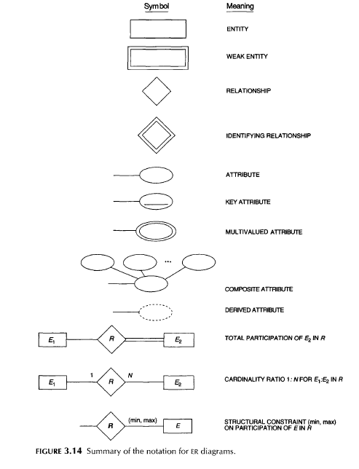

Slide 32
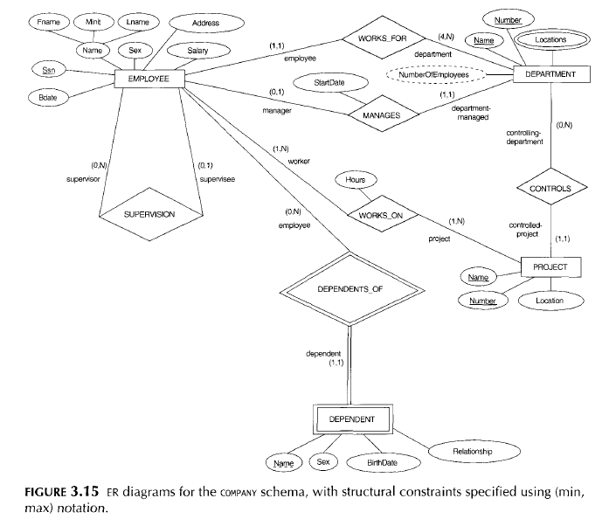

Slide 33
ER DIAGRAMS, NAMING CONVENTIONS,AND DESIGN ISSUES
Figure 3.2 displays the COMPANY ER database schema as an ER diagram.
Entity types such as EMPLOYEE, DEPARTMENT, and PROJECT are shown in rectangular boxes.
Relationship types such as WORKS_FOR, MANAGES, CONTROLS, and WORKS_ON are shown in diamond-shaped boxes attached to the participating entity types with straight lines.
Attributes are shown in ovals, and each attribute is attached by a straight line to its entity type or relationship type.
Component attributes of a composite attribute are attached to the oval representing the composite attribute, as illustrated by the Name attribute of EMPLOYEE.
Multivalued attributes are shown in double ovals, as illustrated by the Locations attribute of DEPARTMENT.
Key attributes have their names underlined.
Derived attributes are shown in dotted ovals, as illustrated by the NumberOfEmployees attribute of DEPARTMENT.
Weak entity types are distinguished by being placed in double rectangles and by having their identifying relationship placed in double diamonds.
The partial key of the weak entity type is underlined with a dotted line.
the cardinality ratio of each binary relationship type is specified by attaching
a I, M, or N on each participating edge.
The cardinality ratio of DEPARTMENT: EMPLOYEE in MANAGES is 1:1,
whereas it is l:N for DEPARTMENT: EMPLOYEE in WORKS_FOR, and M:N for WORKS_ON.

Slide 34
MANAGES
a 1:1 relationship type between EMPLOYEE and DEPARTMENT. EMPLOYEE participation is partial.
DEPARTMENT participation is not clear from the requirements. We question the users, who say that a department must have a manager at all times, which implies total participation. The attribute StartDate is assigned to this relationship type.
2. WORKSFOR,
a I:N relationship type between DEPARTMENT and EMPLOYEE. Both participations are total.
3. CONTROLS,
a I:N relationship type between DEPARTMENT and PROJECT.
The participation of PROJECT is total, whereas that of DEPARTMENT is determined to be partial, after consultation with the users indicates that some departments may control no projects.

Slide 35
REFINING THE ER DESIGN FOR THE COMPANY DATABASE
4. SUPERVISION
a I:N relationship type between EMPLOYEE (in the supervisor role) and EMPLOYEE (in the supervisee role).
Both participations are determined to be partial, after the users indicate that not every employee is a supervisor and not every employee has a supervisor.
5. WORKS_ON
determined to be an M:N relationship type with attribute Hours, after the users indicate that a project can have several employees working on it. Both participations are determined to be total.
6. DEPENDENTS_OF
a l:N relationship type between EMPLOYEE and DEPENDENT, which is also the identifying relationship for the weak entity type DEPENDENT. The participation of EMPLOYEE is partial, whereas that of DEPENDENT is total.

Slide 36
ER DIAGRAMS, NAMING CONVENTIONS,AND DESIGN ISSUES
See figure 3.14 :Summary of the notation for ER diagrams on page 72
See Figure 3.2 ER database schema as an ER diagram with the notation
Also FIGURE 3.15 ER diagrams for the COMPANY schema, with structural constraints specified using (min, max) notation and also Role names of the company Database.

Slide 37
Mapping ER-models to Relational Tables
steps of an algorithm for ER-to-relational mapping
Step 1: Mapping of Regular Entity Types
For each regular (strong) entity type E in the ER schema, create a relation R that includes all the simple attributes of E
Choose one of the key attributes of E as primary key for R.
Put the primary key of the table as the foreign key in to the second table for referential integrity
Foreign keys in company database include the attributes SUPERSSN and DNO of EMPLOYEE, MGRSSN and MGRSTARTDATE of DEPARTMENT, and DNUM of PROJECT
SSN, DNUMBER, and PNUMBER as primary keys for the relations EMPLOYEE, DEPARTMENT, and PROJECT respectively

Slide 38
Step 2:Mapping of Weak Entity Types.
For each weak entity type W in the ER schema with owner entity type E, create a relation R and include all simple attributes(or simple components of composite attributes) of W as attributes of R
In addition, include as foreign key attributes of R the primary key attributes) of the relations) that correspond to the owner entity types):
this takes care of the identifying relationship type of W
The primary key of R is the combination of the primary keys) of the owners) and the partial key of the weak entity type W, if any
We include the primary key SSN of the EMPLOYEE relation-which corresponds to the owner entity type-as a foreign key attribute of DEPENDENT; and renamed it ESSN.
The primary key of the DEPENDENT relation is the combination {ESSN, DEPENDENT_NAME} because DEPENDENT_NAME is the partial key of DEPENDENT

Slide 39
Step 3: Mapping of Binary 1:1 Relationship Types
For each binary 1:1 relationship type R in the ER schema, identify the relations S and T that correspond to the entity types participating in R
Use the foreign key approach
That is Choose one of the relations-S, say-and include as a foreign key in S the primary key of T.
It is better to choose an entity type with total participation in R in the role of S.
example, we map the 1:1 relationship type MANAGES from by choosing the participating entity type DEPARTMENT to serve in the role of S, because its participation in the MANAGES relationship type is total (every department has a manager).
We include the primary key of the EMPLOYEE relation as foreign key in the DEPARTMENT relation and rename it MGRSSN.
We also include the simple attribute STARTDATE of the MANAGES relationship type in the DEPARTMENT relation and rename it MGRSTARTDATE.

Slide 40
Step 4: Mapping of Binary 1 :N Relationship Types
For each regular binary l:N relationship type R, identify the relation S that represents the participating entity type at the N-side of the relationship type
Include as foreign key in S the primary key of the relation T that represents the other entity type participating in R
Example:
For WORKS_FOR we include the primary key DNUMBER of the DEPARTMENT relation as foreign key in the EMPLOYEE relation and call it DNO.
For SUPERVISION we include the primary key of the EMPLOYEE relation as foreign key in the EMPLOYEE relation itself because the relationship is recursive-and call it SUPERSSN.
The CONTROLS relationship is mapped to the foreign key attribute DNUM of PROJECT, which references the primary key DNUMBER of the DEPARTMENT relation.

Slide 41
Step 5: Mapping of Binary M:N Relationship Types.
For each binary M:N relationship type R, create a new relation S to represent R
Include as foreign key attributes in S the primary keys of the relations that represent the participating entity types;
their combination will form the primary key of S
We cannot represent an M:N relationship type by a single foreign key attribute in one of the participating relations (as we did for 1:1 or I:N relationship types) because of the M:N cardinality ratio; we must create a separate relationship relation S.
Example: we map the M:N relationship type WORKS_ON by creating the relation WORKS_ON ,We include the primary keys of the PROJECT and EMPLOYEE relations as foreign keys in WORKS_ON and rename them PNO and ESSN, respectively
The primary key of the WORKS_ON relation is the combination of the foreign key attributes {ESSN, PNO}.

Slide 42
Step 6: Mapping of Multivalued Attributes.
For each multivalued attribute A, create a new relation R.
This relation R will include an attribute corresponding to A, plus the primary key attribute K-as a foreign key in R
The primary key of R is the combination of A and K
example, we create a relation DEPT_LOCATIONS.
The attribute DLOCATION represents the multivalued attribute LOCATIONS of DEPARTMENT, while DNUMBER-as foreign key represents the primary key of the DEPARTMENT relation.
The primary key of DEPT_LOCATIONS is the combination of {DNUMBER, DLOCATION}.
A separate tuple will exist in DEPT_LOCATIONS for each location that a department has.

Slide 43
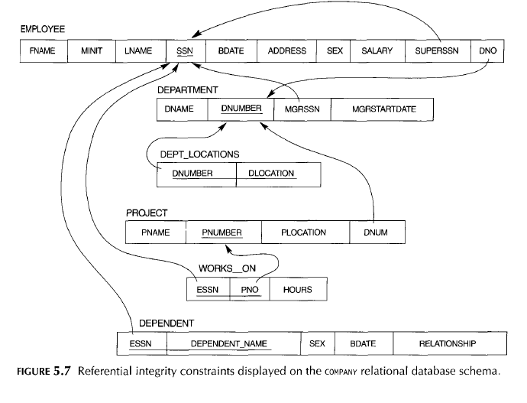

Slide 44
Figure Result of mapping the COMPANY ER schema into a relational database schema.
AND
See populated company Database with sample Data on the next Slide

Slide 45
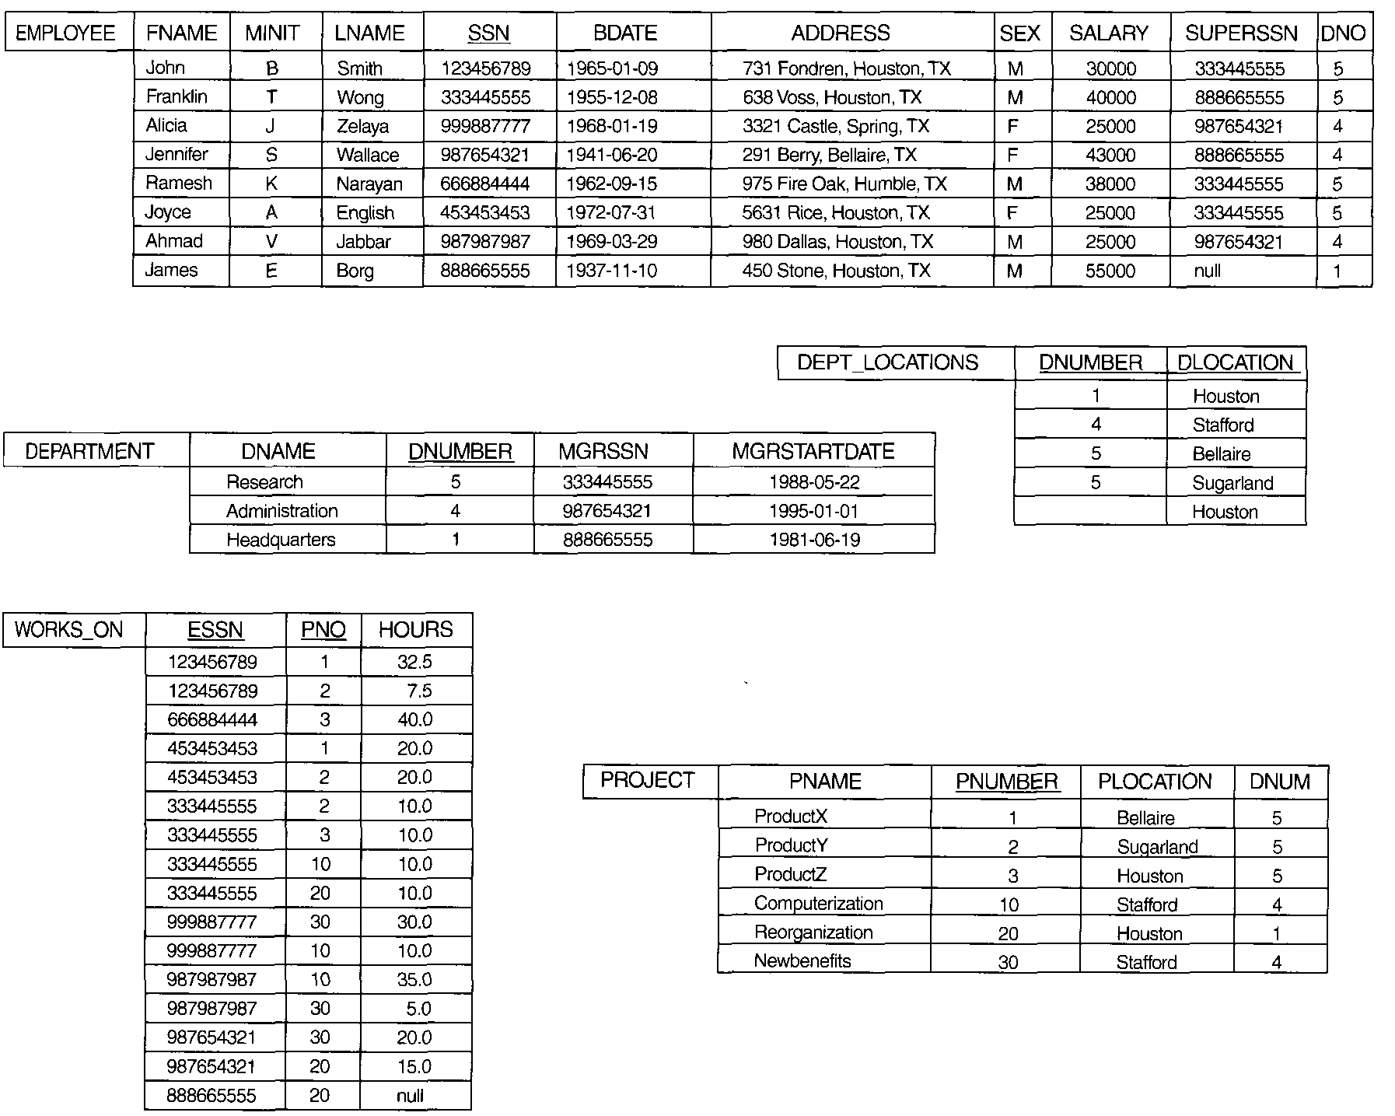

Slide 46
